Slide 1
The Dynamics of a China-US Partnership

Slide 2
It all started in the summer of 2006 because of “the grid”

Slide 3


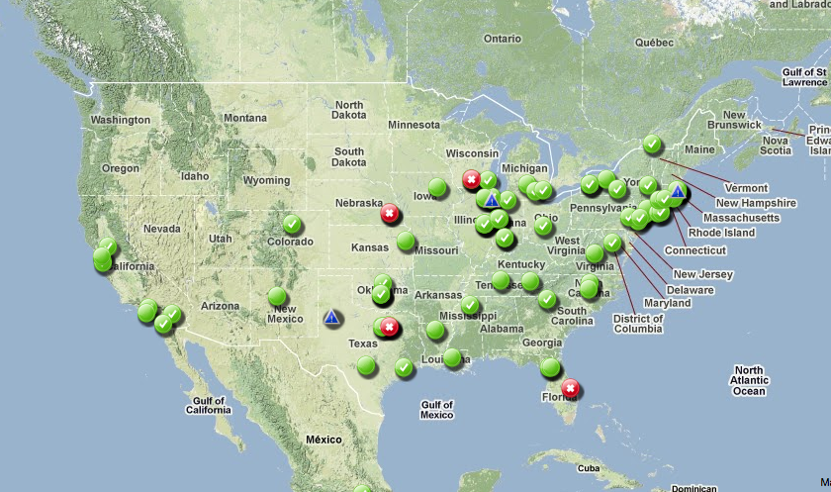
Open Science Grid (OSG)
HTC at the National Level
Notes:
3

Slide 4




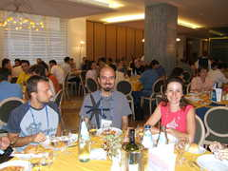
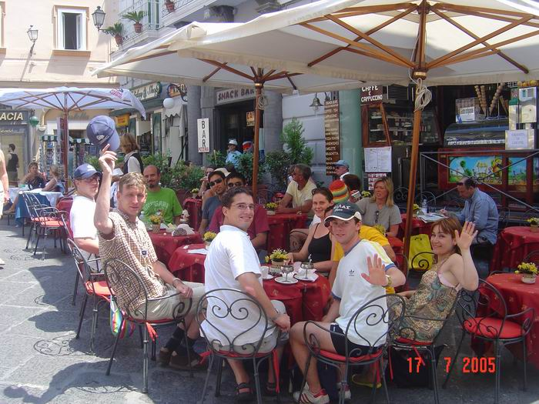
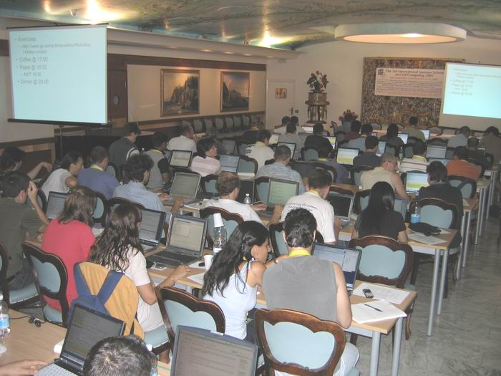
We first met …

Slide 5
Not really …
Date: Fri, 05 Aug 2005 09:38:22 +0200 To: A.Dunlop@omii.ac.uk, p.henderson@omii.ac.uk, alistair@dunlop.com, mpa@nesc.ac.uk, m.parsons@epcc.ed.ac.uk, Robert.Jones@cern.ch, fabrizio.gagliardi@cern.ch, Giorgio.Maggi@ba.infn.it, mirco.mazzucato@pd.infn.it, johnsson@tlc2.uh.edu, anders.ynnerman@snic.vr.se, mulmo@pdc.kth.se, Dieter.Kranzlmueller@cern.ch, Tony.Hey@epsrc.ac.uk, foster@mcs.anl.gov, carl@isi.edu, vwelch@ncsa.uiuc.edu, miron@cs.wisc.edu, depeiq@263.net, xhxie@ict.ac.cn, hucm@act.buaa.edu.cn, huaijp@buaa.edu.cn, SunHL@act.buaa.edu.cn, ph.wieder@fz-juelich.de, d.erwin@fz-juelich.de, a.streit@fz-juelich.de, David.Snelling@uk.fujitsu.com, Sven.vandenBerghe@uk.fujitsu.com From: Francis Wray <frannie@large.demon.co.uk> Subject: OMII-Europe Telecom

Slide 6

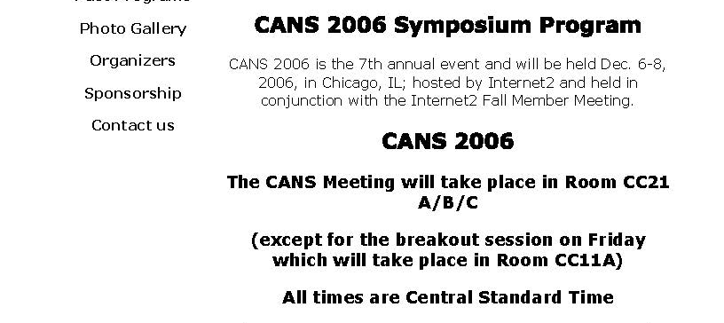

Slide 7
Date: Fri, 8 Dec 2006 09:48:36 +0800 Dear Miron, So happy to hear from you. I found your name on the list of participants. It's a pity that I could not listen to your presentation because I have to leave earlier for meeting this morning. I believe that we have a good opportunity in future cooperation. Condor is such a famous system. Our team will definitely benefit from learning from Condor technologies. More important, we can set up cooperative relation with OSG via Condor. We hope that you will visit us in the coming year. The Spring or Fall are good times in both Beijing and Xi'an. It will be my great honor to invite you to give talks to our research teams. Best wishes. Depei . Sent: 2006-12-08 04:16:42 +0800 Subject: It was good seeing you! >Depei, > >It was great seeing you on the screen today. Very nice talk and >definitely very impressive accomplishments. You are making good >progress. I hope that in the future, your report will also include >contributions from Condor technologies. Lets hope! > >Regards from a very cold Chicago. > >Miron

Slide 8
Condor
An open source software stack designed to manage ensembles of computational tasks (10**5) on large (10**4), heterogeneous distributed computing resources that can reside on desktops, in machine rooms and in cloud data centers. Has been widely adopted by academic and commercial organization to support their High Throughput Computing needs.

Slide 9
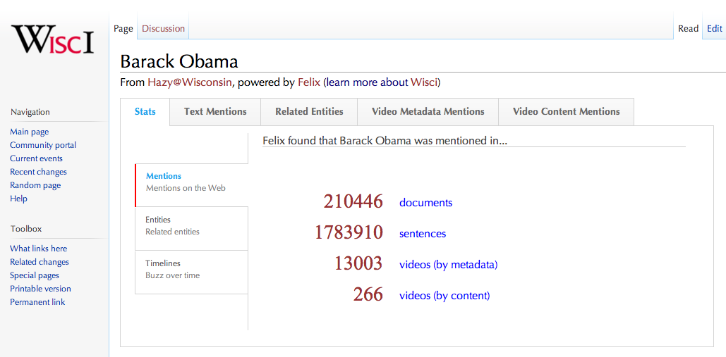
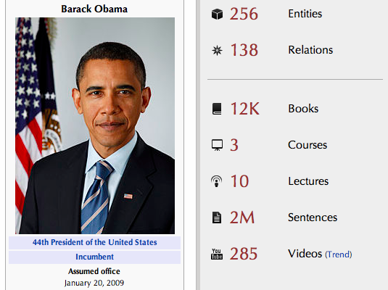
Condor enabled us to build Wisci/DeepDive:
Enriching Wikipedia with the Web
Some Information
50TB Data
500K Machine-hours
500M Webpages
400K Videos
20K Books
7Bn Entity Mentions
114M Relationship Mentions
We use CHTC (Condor) for
Web Crawling
Information Extraction
Deep Linguistic Processing
Audio/Video Transcription
Tera-byte Parallel Joins
MapReduce Task Processing
http://www.cs.wisc.edu/hazy/wisci/ for more information.
Notes:
In the Wisci project, one goal is to improve the recall of Wikipedia. Wisci is supported by a system called Felix that performs statistical analysis on large data sets. At this early stage, Wisci has already processed 10s of TBs of data from half a billion webpages and over 200K videos, and is performing deep semantic analysis on billions of sentences.
The page you see is Barack Obama’s page on Wisci. We can see that Felix found Barack Obama mentioned in 200K web documents, in 1.8M sentences, and in tens of thousands of videos. Whiskey creates a page for every person, place, or thing in Wikipedia.

Slide 10
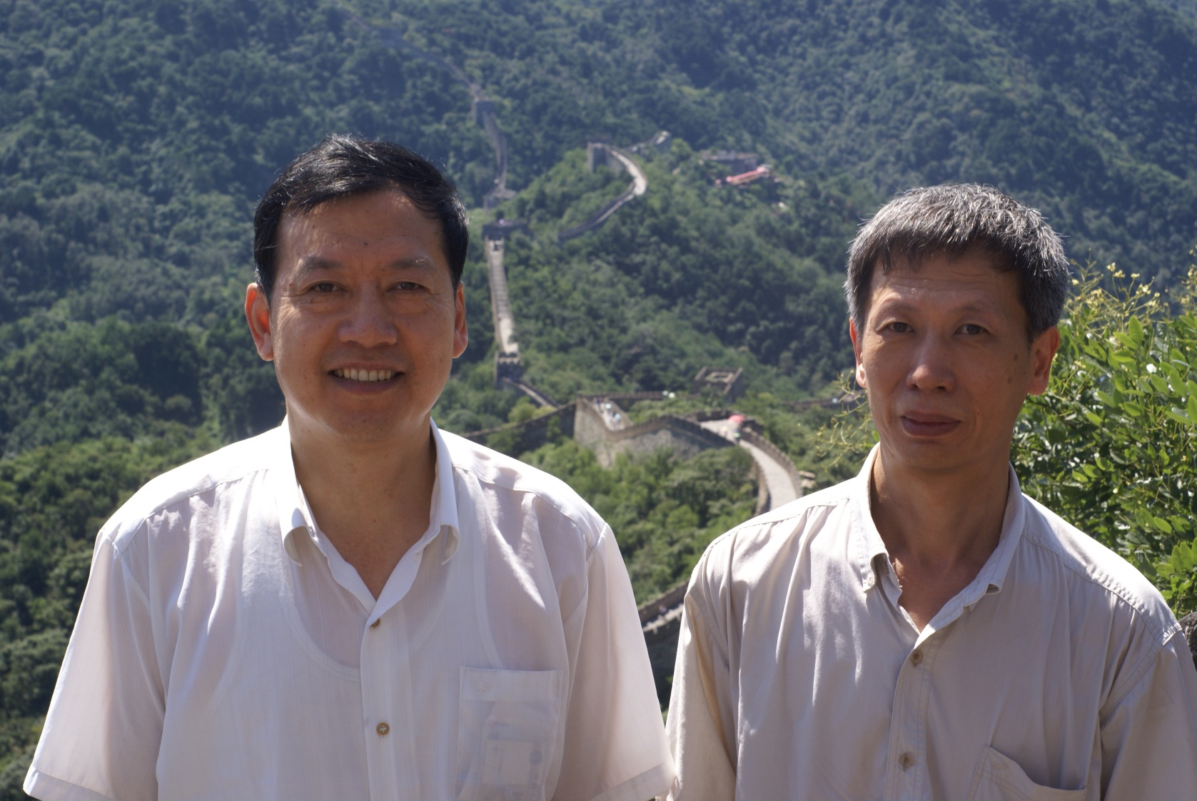
Friendship …

Slide 11
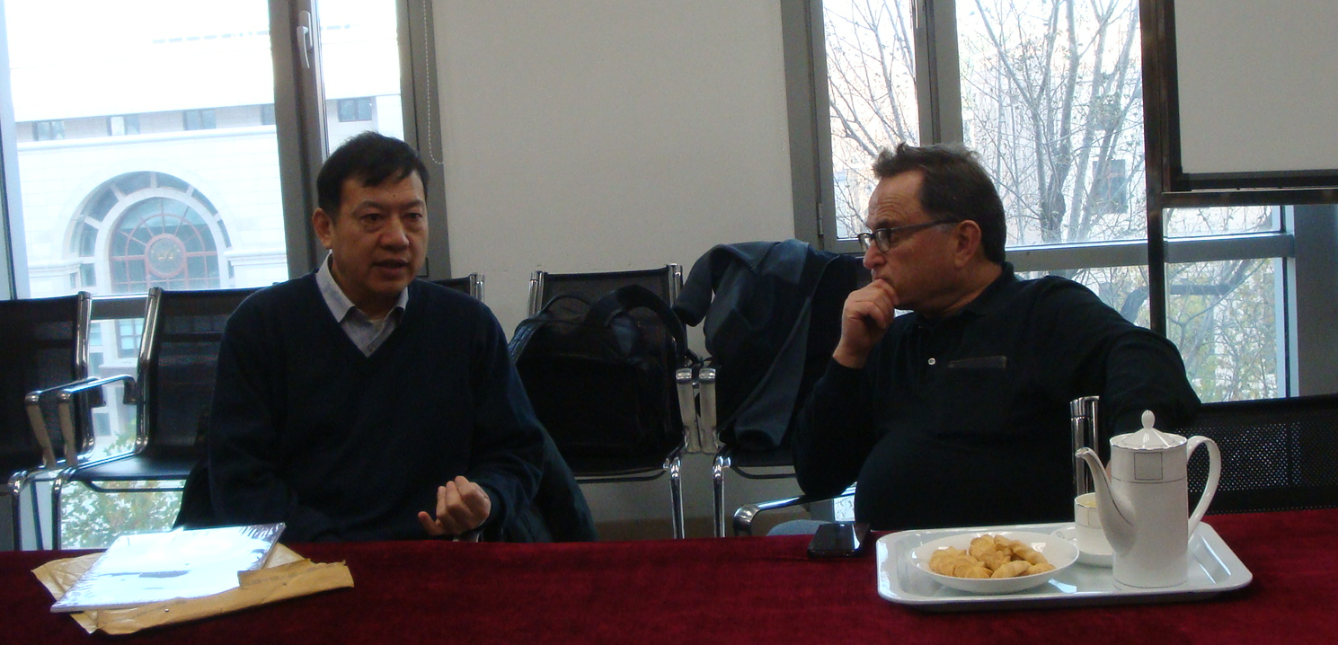
Mutual understanding …

Slide 12
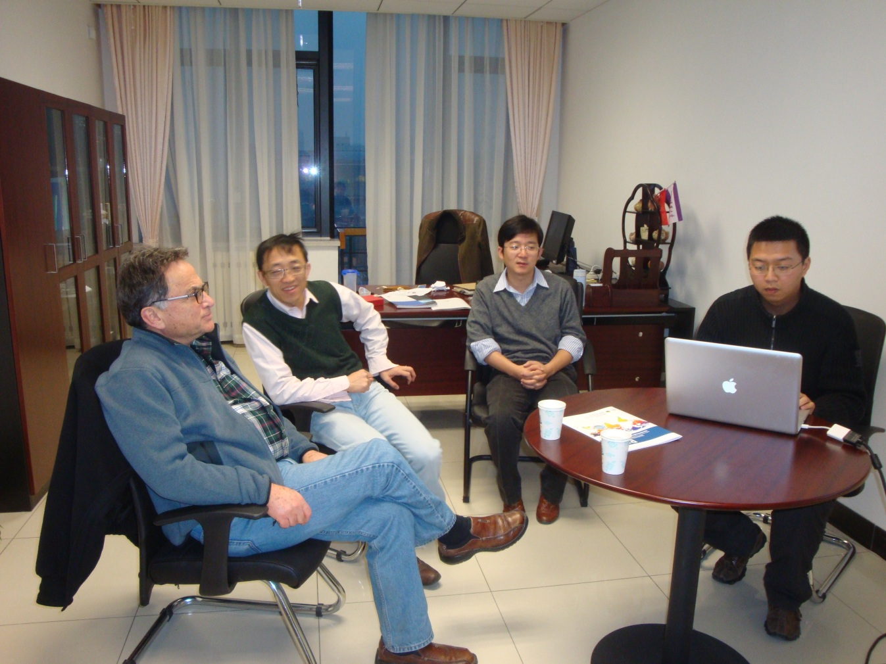
Broad Interactions …

Slide 13
Impact …
Dear Prof. Miron Livny,
Tencent inc. which is the biggest Internet corp. in China have developed an infrastructure level resource management system called T-borg, which followed Condor technology. When they heard that you will have keynote about Condor on HiC2011, they want to invite you to visit their headquarter in ShenZhen and give a talk there.

Slide 14
Commitment …
Extended visits - weeks to months
Broad interactions – 1-1, group, lectures, tutorials, seminars, schools, conferences
Mature open source technologies – can be extended, integrated into projects and deployed in production
Sustained communication channels

Slide 15
